Slide 1

FALL SEMESTER 2021-22.
Review: 1.
Internet and Web Programming.
(CSE3501)
L55+L56
SCHOOL OF COMPUTER SCIENCE AND ENGINEERING

Slide 2
Turbo Tenant – A House rental management system.
1. | B Sai Mohan | 19BCI0019
2. | Bhanu Prakash | 19BCI0057
3. | B Abhiram | 19BCI0005
4. | Ruman | 19BCI0056
24th September 2021.
Under the Guidance of:
Prof. Lydia Jane

Slide 3
Functionalities:
Login and Signup functionality.
Adding members to be staying along with tenant to stay.
Adding the new owners to the portal, who wish to rent their property.
Dynamically view the remaining houses empty for being rented.
Members and owners can rate and provide feedback.
Booking by the tenant made simple.
Agreement between both parties can be uploaded on the portal.
Separate signup for tenant and owner.
Friendly Home Page for better navigation of incoming users.
Current users have ability to provide suggestions, rate the website.
Relational database usage for better searching and fetching purposes.

Slide 4
Tech stack planned to use:
HTML.
CSS.
Bootstrap.
JavaScript.
NodeJS.
PHP/EJS (for any other purposes if required).
MySQL.
Other required dependencies.
PNG images.
Screenshots of completed work:

Slide 5
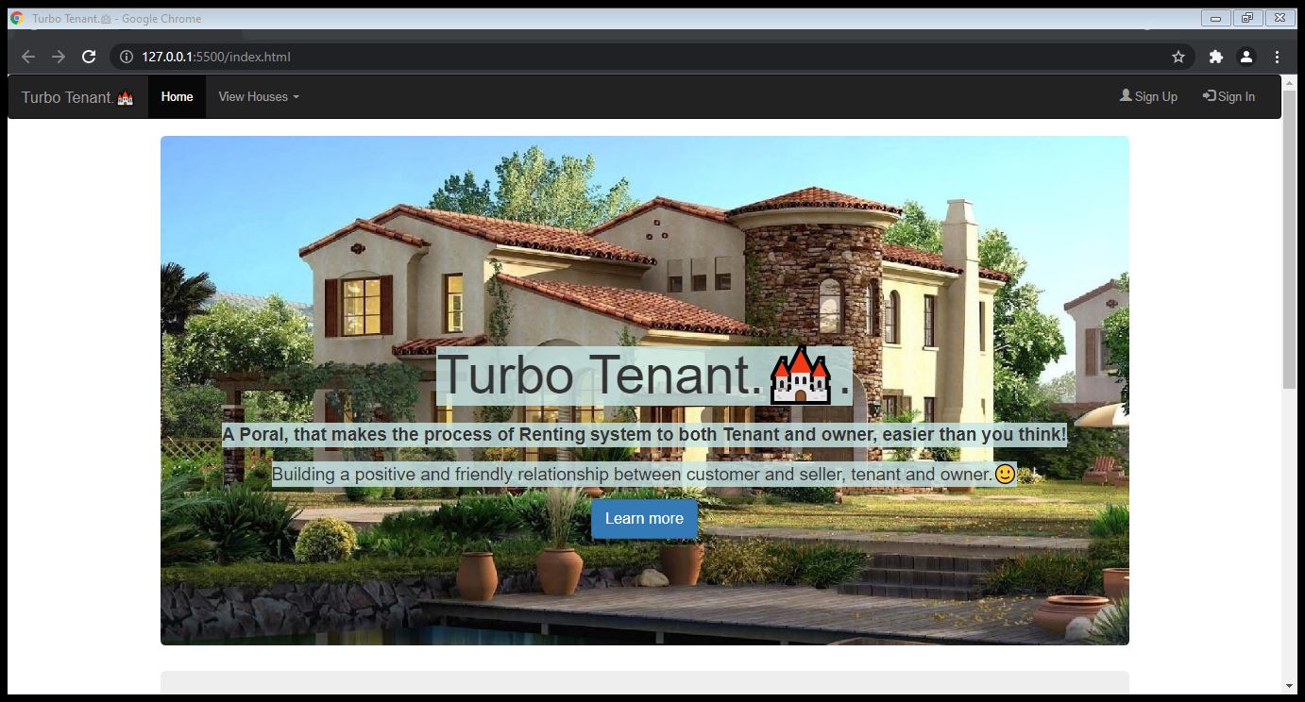

Slide 6
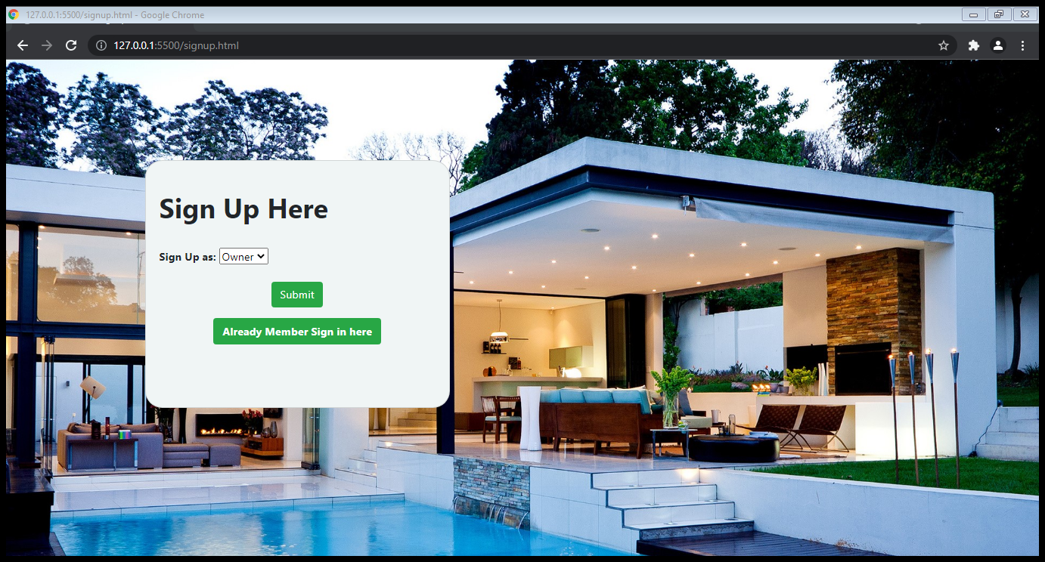

Slide 7
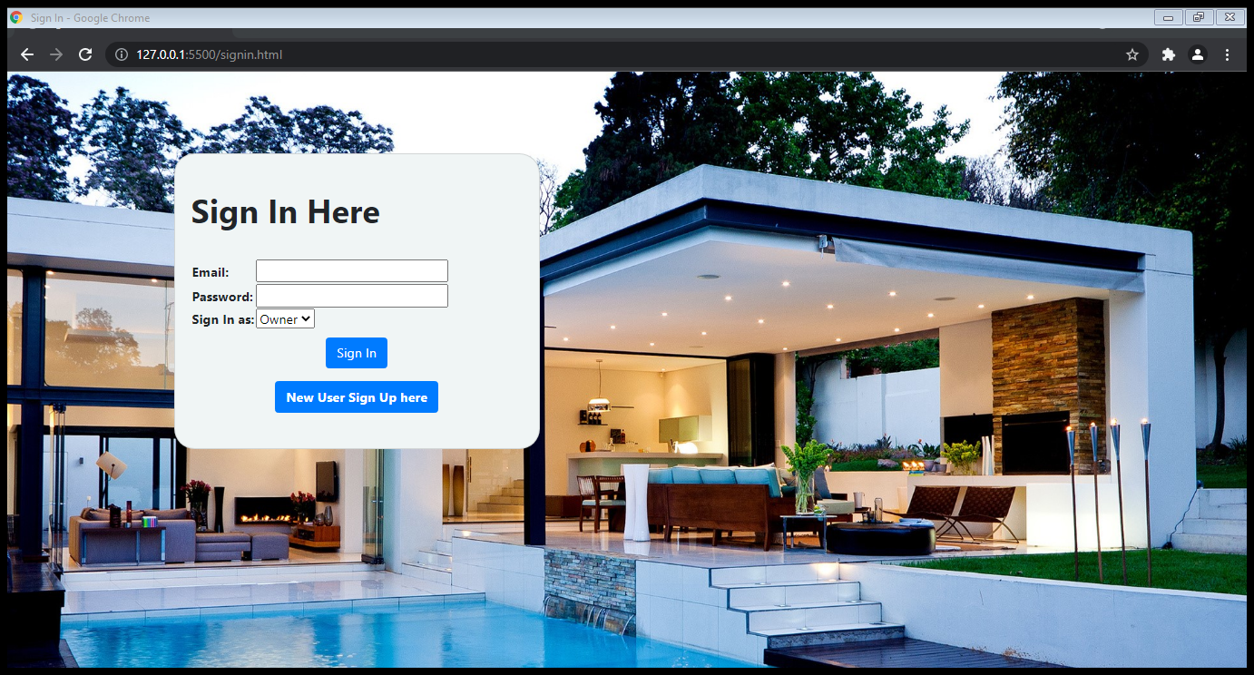

Slide 8
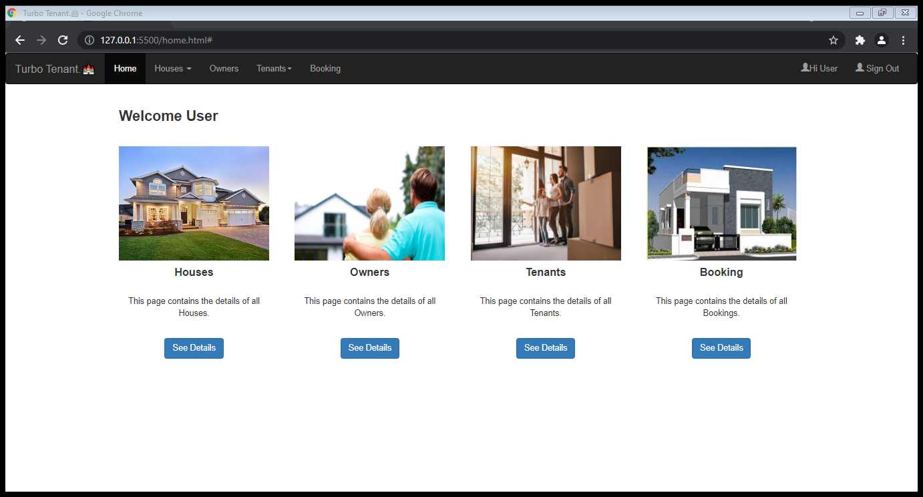

Slide 9
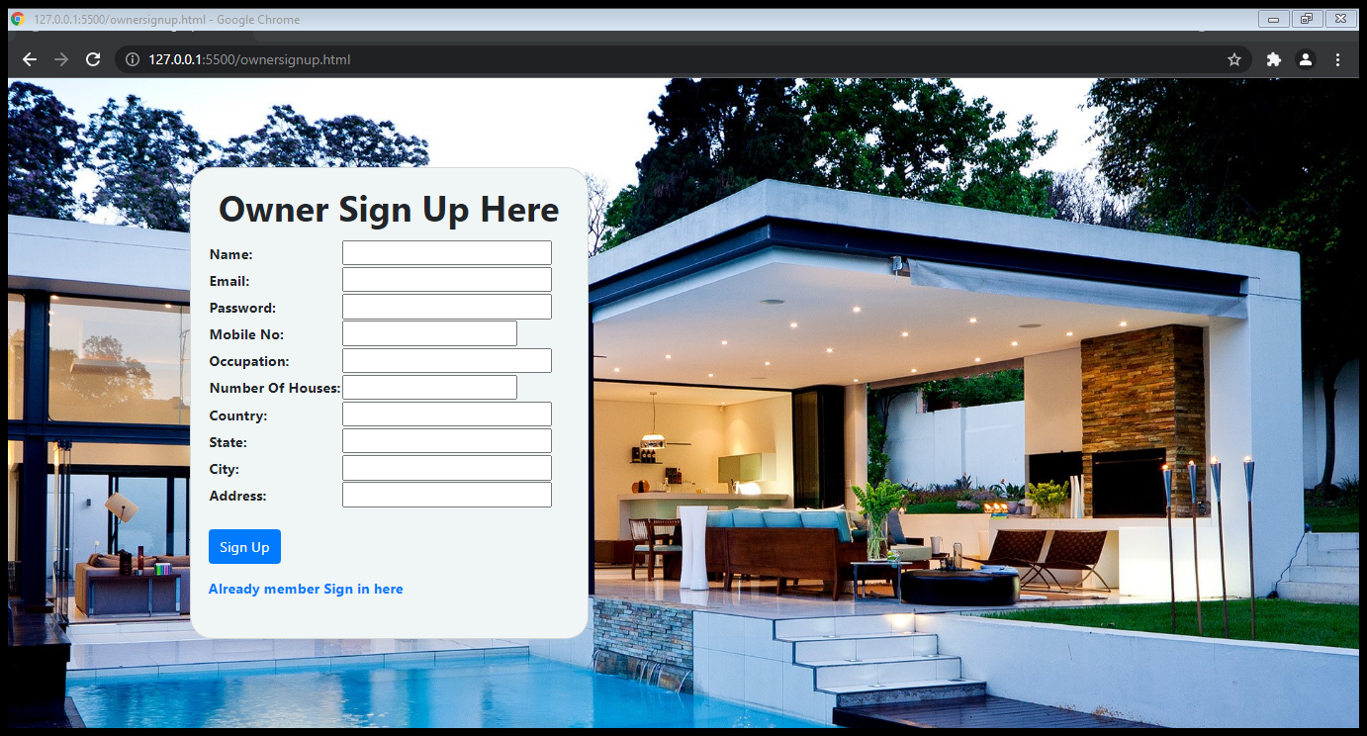

Slide 10
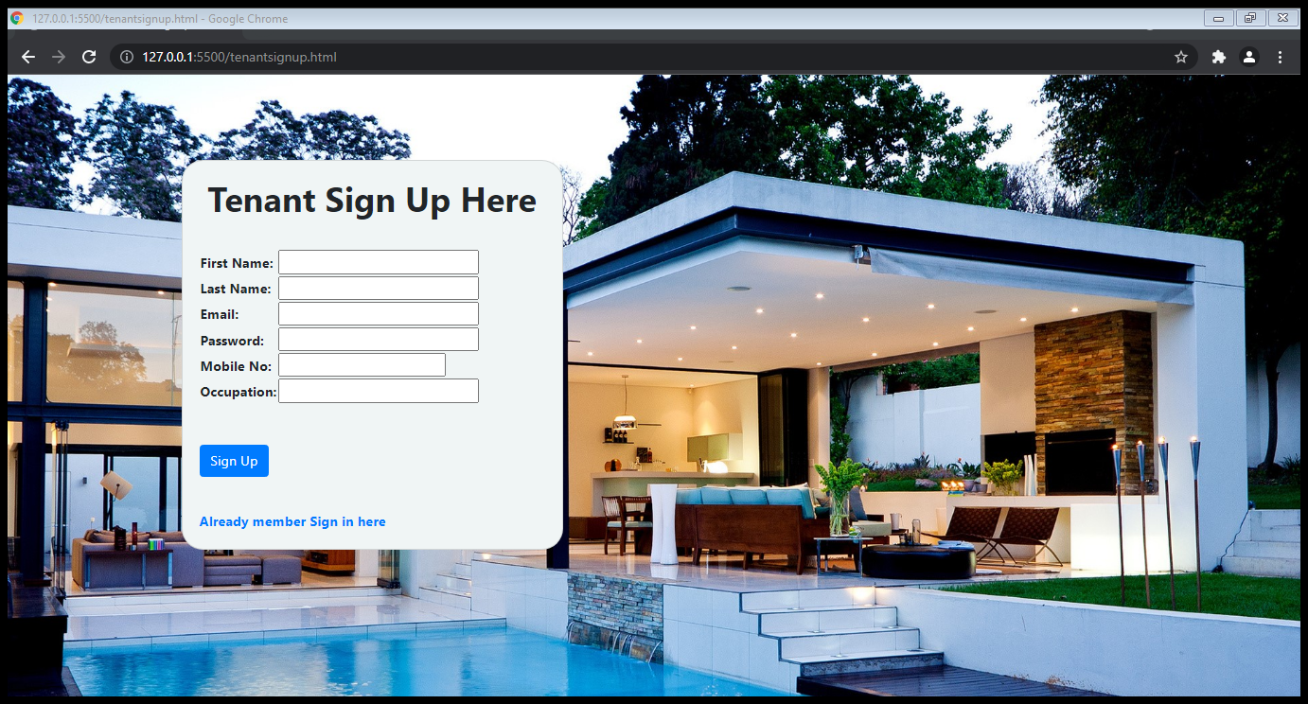

Slide 11
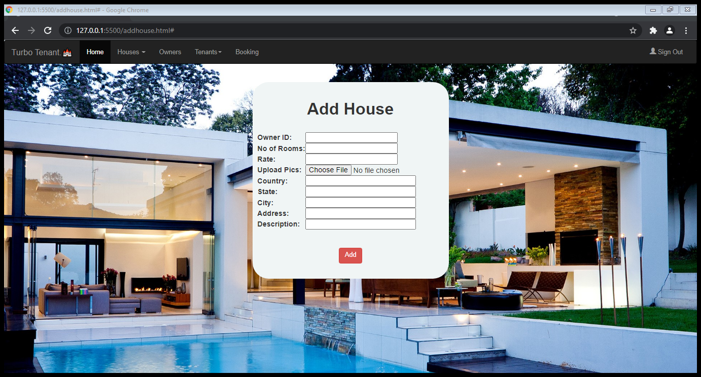

Slide 12
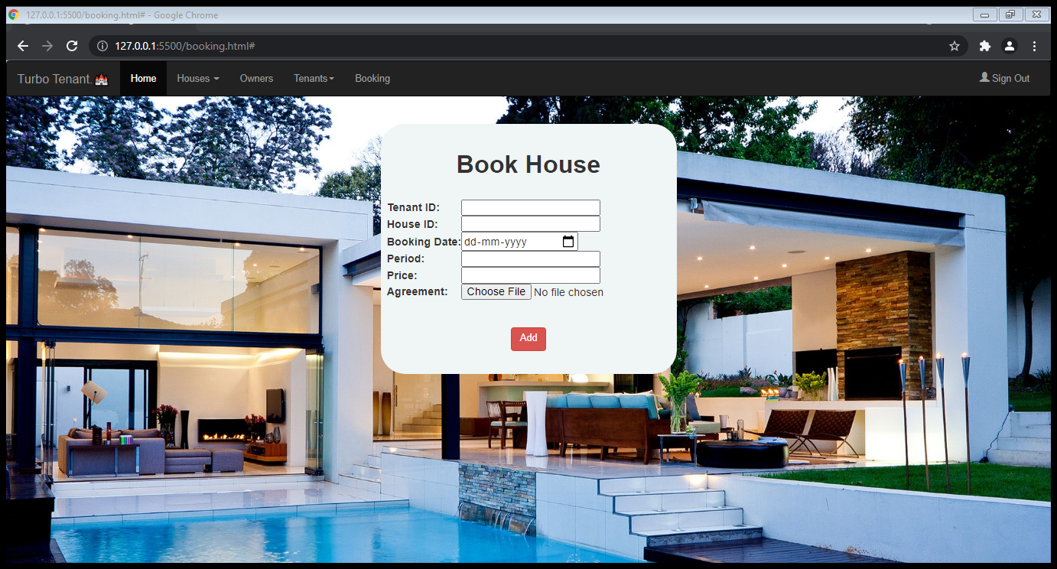

Slide 13
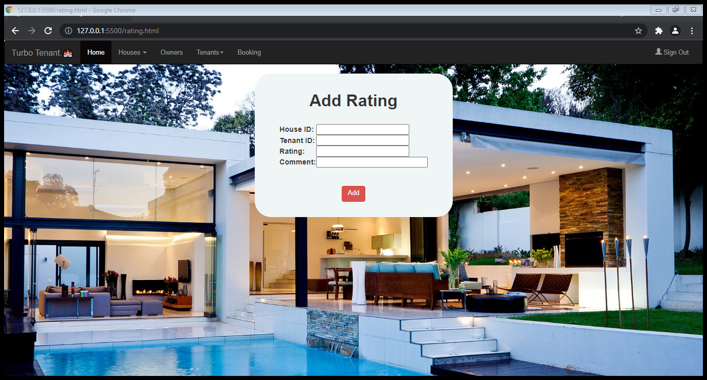

Slide 14
Thank you, ma’am.

